Slide 1
A2 -Network
A 2.1 Network fundamentals

Slide 2




Do Now Activity (5 mins)
TOK
Does easier access to information through the internet mean we actually know more, or just that we can find information faster?
L1 : Explain what is a network ?
L2: Mention types of networking with example ?
L3: List all the devices they have used today that connect to the internet or to another device.
Learning Intention: Describe the purpose of networks, understand key network characteristics, and differentiate between LANs, WANs, PANs, and VPNs
Success Criteria:
Students will be able to analyse the flow of instructions through a pipeline and identify potential hazards.
Students will be able to evaluate the impact of pipelining on instruction throughput and execution time.
Students will be able to explain the advantages of multi-core processors for multitasking and parallel processing.

Slide 3
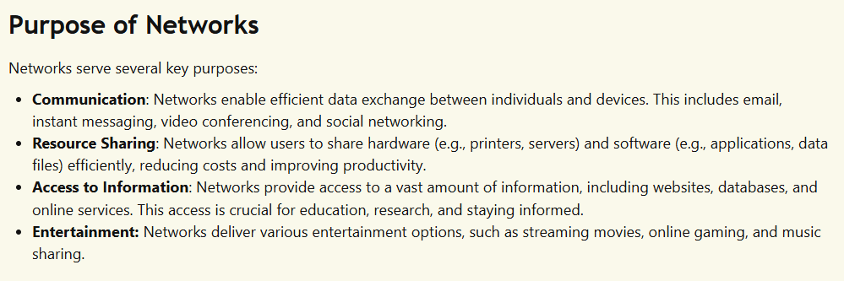
Why Do We Need Networks?

Slide 4
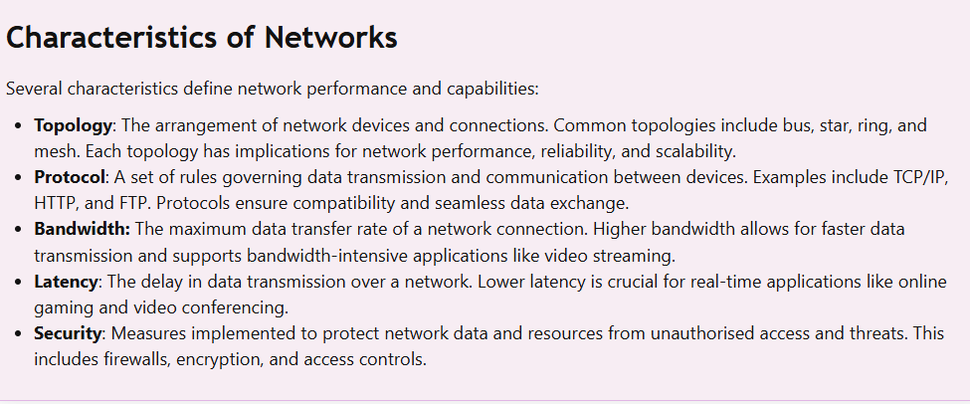
How Do Networks Work?

Slide 5
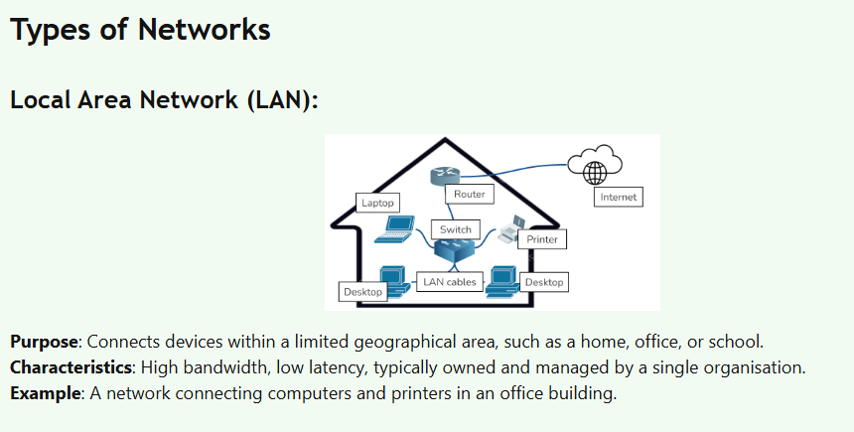

Slide 6
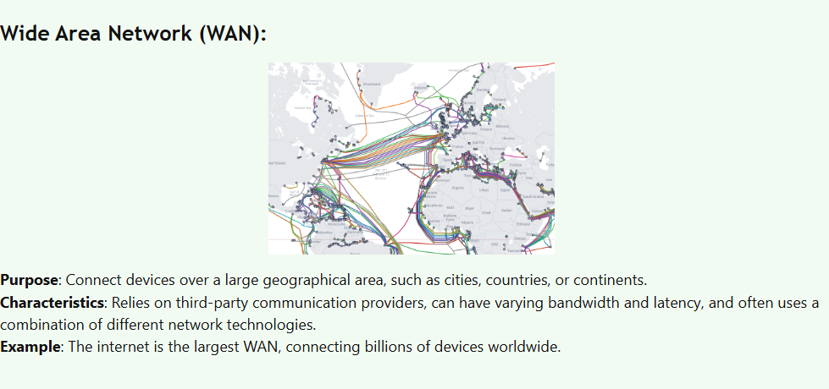

Slide 7
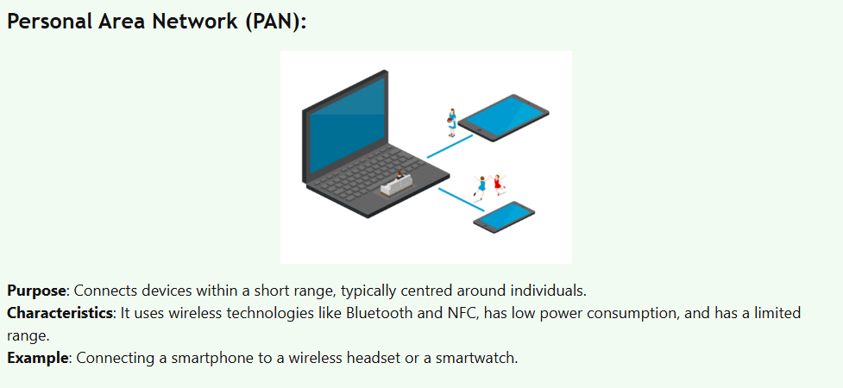

Slide 8
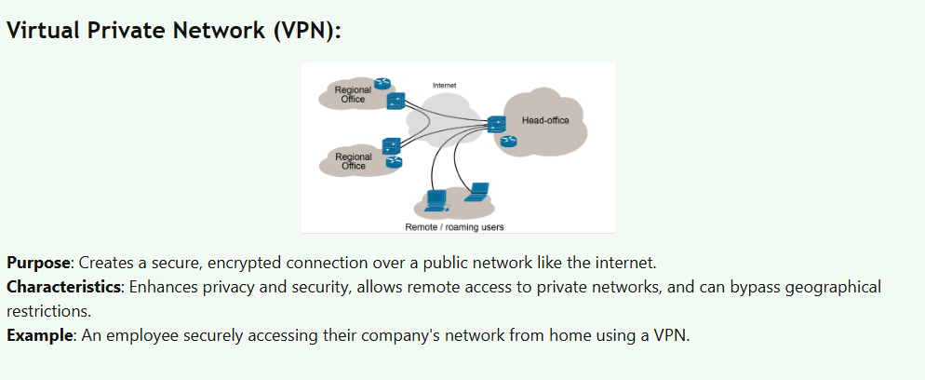

Slide 9
Challenging Activities - 20 mins
Exam-Style Questions
Question 1 (3 marks)
A student connects their laptop to the school printer and shared files while inside the school building.
(a) Identify the type of network being used. (1)
(b) State two characteristics of this type of network. (2)
Question 2 (4 marks)
During an online video call, the video freezes and the audio arrives late even though the internet speed is high.
(a) Identify the network characteristic causing the delay. (1)
(b) Explain why this affects video conferencing. (2)
(c) Suggest one way to improve the situation. (1)
Question 3 (5 marks)
A company allows employees to access the office system from home using a secure connection over the internet.
(a) Identify the type of network technology used. (1)
(b) Describe how it works. (2)
(c) State two advantages of using this technology. (2)

Slide 10
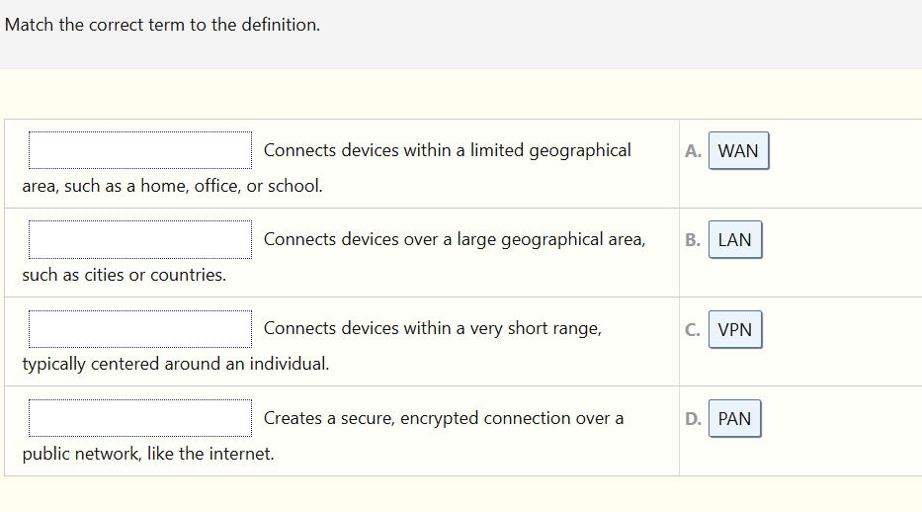
Plenary

